Slide 2

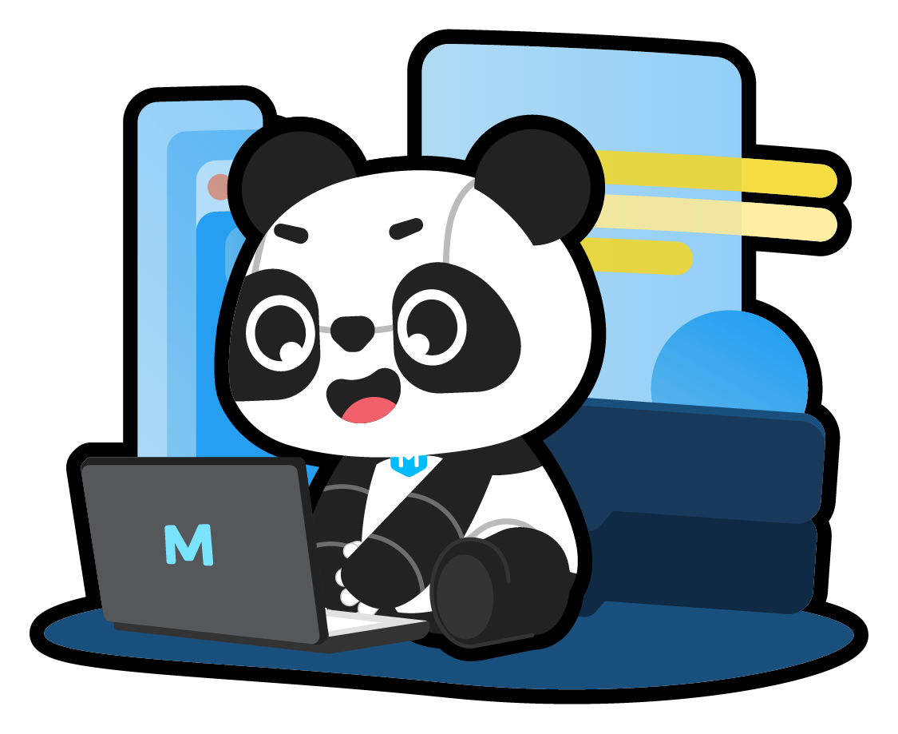
Hello, everyone!
I'm an engineer from
the smart star.
You can call me Panda!

Slide 3
In future lessons,
we will study
programming together!

Slide 4
Do you know what can you do with programming?

Slide 5
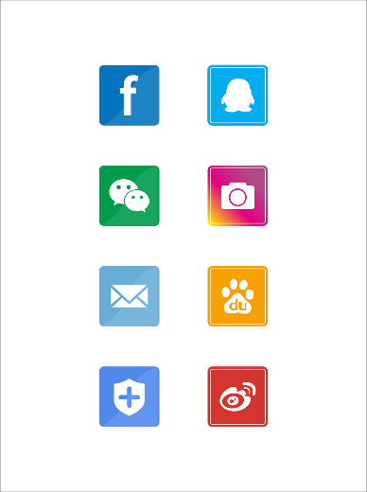
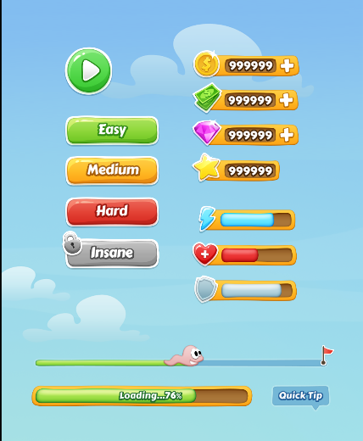
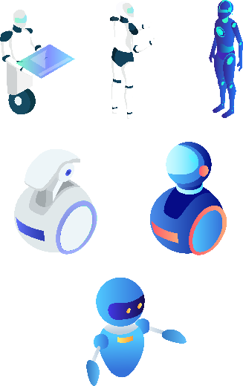
Programming is used to create mobile phone software and apps.
Programming is used to design and create computer games.
Programming is used to control robots.

Slide 6


Game Time

Slide 7
Explore a
mBlock Project

Slide 8
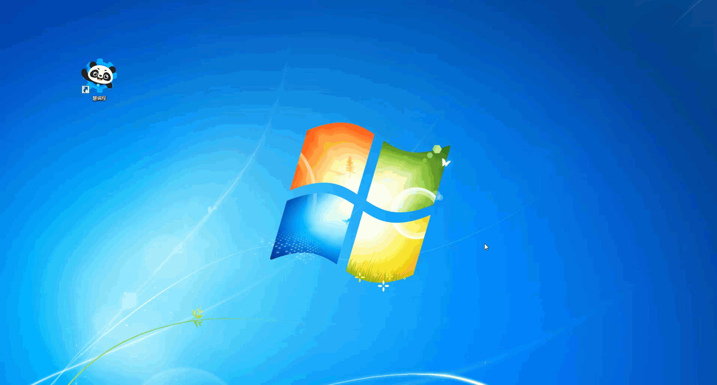
Step 1: Open the mBlock software from your desktop or the mBlock website.

Slide 9

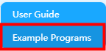
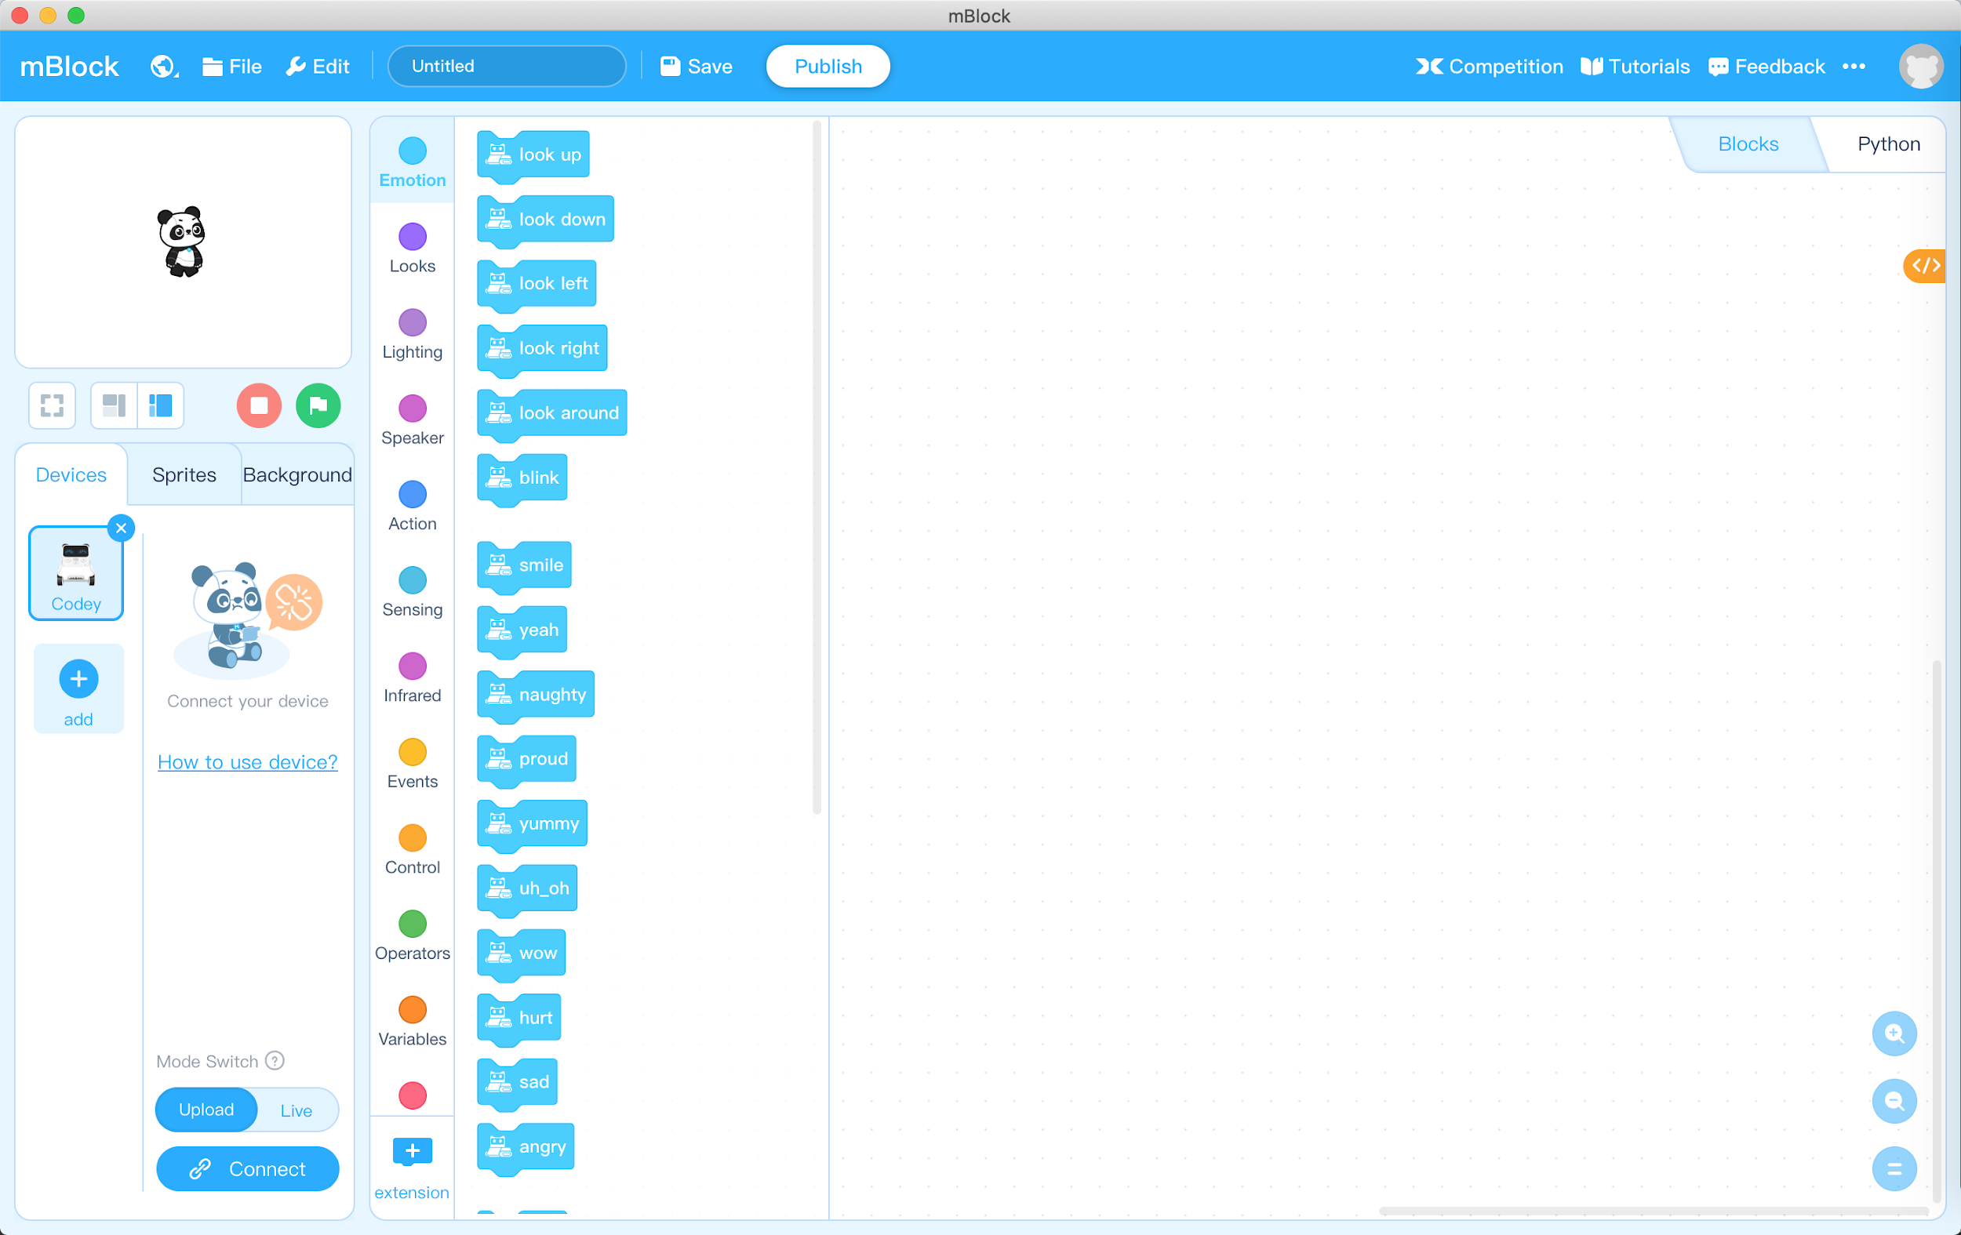
Step 2: Click in the upper right corner.
Select Example Programs.
Step 3: Find Space Adventures and then click OK to open the program.

Slide 10
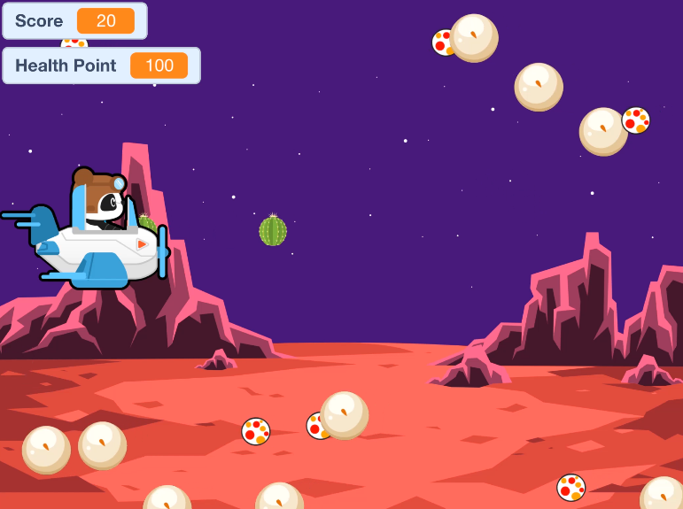
Notes:
Play the video-Lesson 1.

Slide 11




Icon | Name | Function
Green flag
Start the program
Stop
Stop the program
Full screen demonstration
Start full screen mode
Exit full screen
Exit full screen mode

Slide 12

Space Adventures
Use the up and down keys ↑↓ of the keyboard to control the vertical movement of the pilot Panda.
Use the space key to shoot the cannonball from the Panda’s Spaceship.
Play Space Adventures for 3 minutes.

Slide 13
Space Adventures – Competition
Create pairs of students to play the game against each other. If you don’t have a pair, you can have students time themselves and see if they can get a higher score.
Each partner plays the game for one minute.
The student with the highest score after one minute will win.
If the score is the same, the one with the most health points will win.
If the score and the health point are the same, the game will end in a draw.

Slide 14
Space Adventures – Exploration
Explain how to play the game to a classmate (parent or sibling).
Write an explanation of the game.
What is the goal of the game?
How does the game end?
How does the game function?

Slide 15
Let’s Share!

Slide 16
If you could design a game, what kind of game would you design?

Slide 17
Hands-on

Slide 18
Programs in mBlock

Slide 19
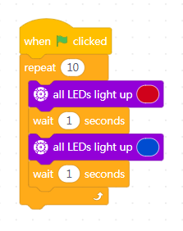
programming
A program is a set of instructions that can be executed by a computer to perform a specific task.
The Space Adventures game is controlled by many programs.

Slide 20
Get to know the
mBlock interface

Slide 21
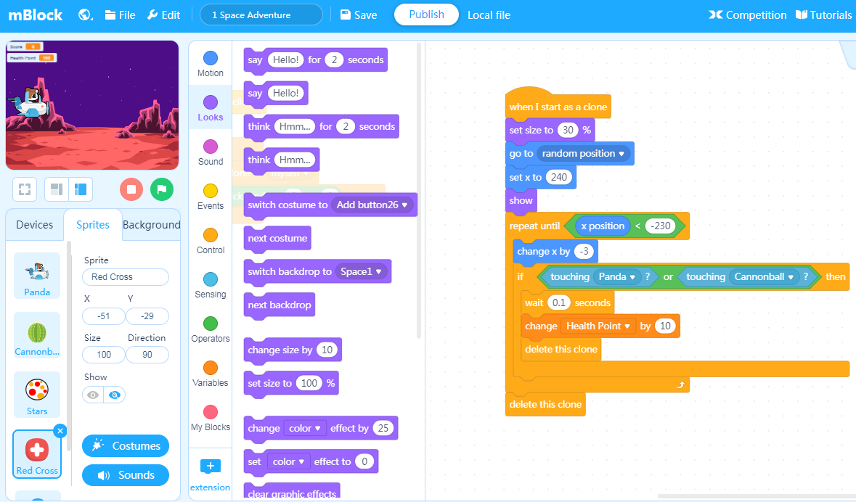
Menu bar
Select language, open new file or save file, find example programs or help documents, etc.
Stage Area
Block Area
Script Area
View project stage, customize sprites and backgrounds, connect Makeblock devices
Library of programming blocks sorted by color-coded categories.
Drag the programming blocks to this area and arrange them to control the performance in the Stage Area.

Slide 22
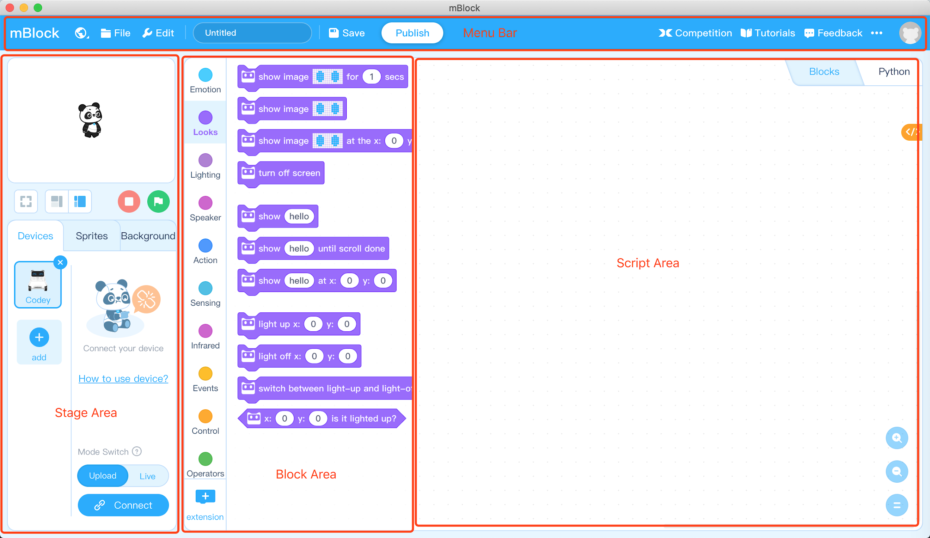
Tasks

Slide 23


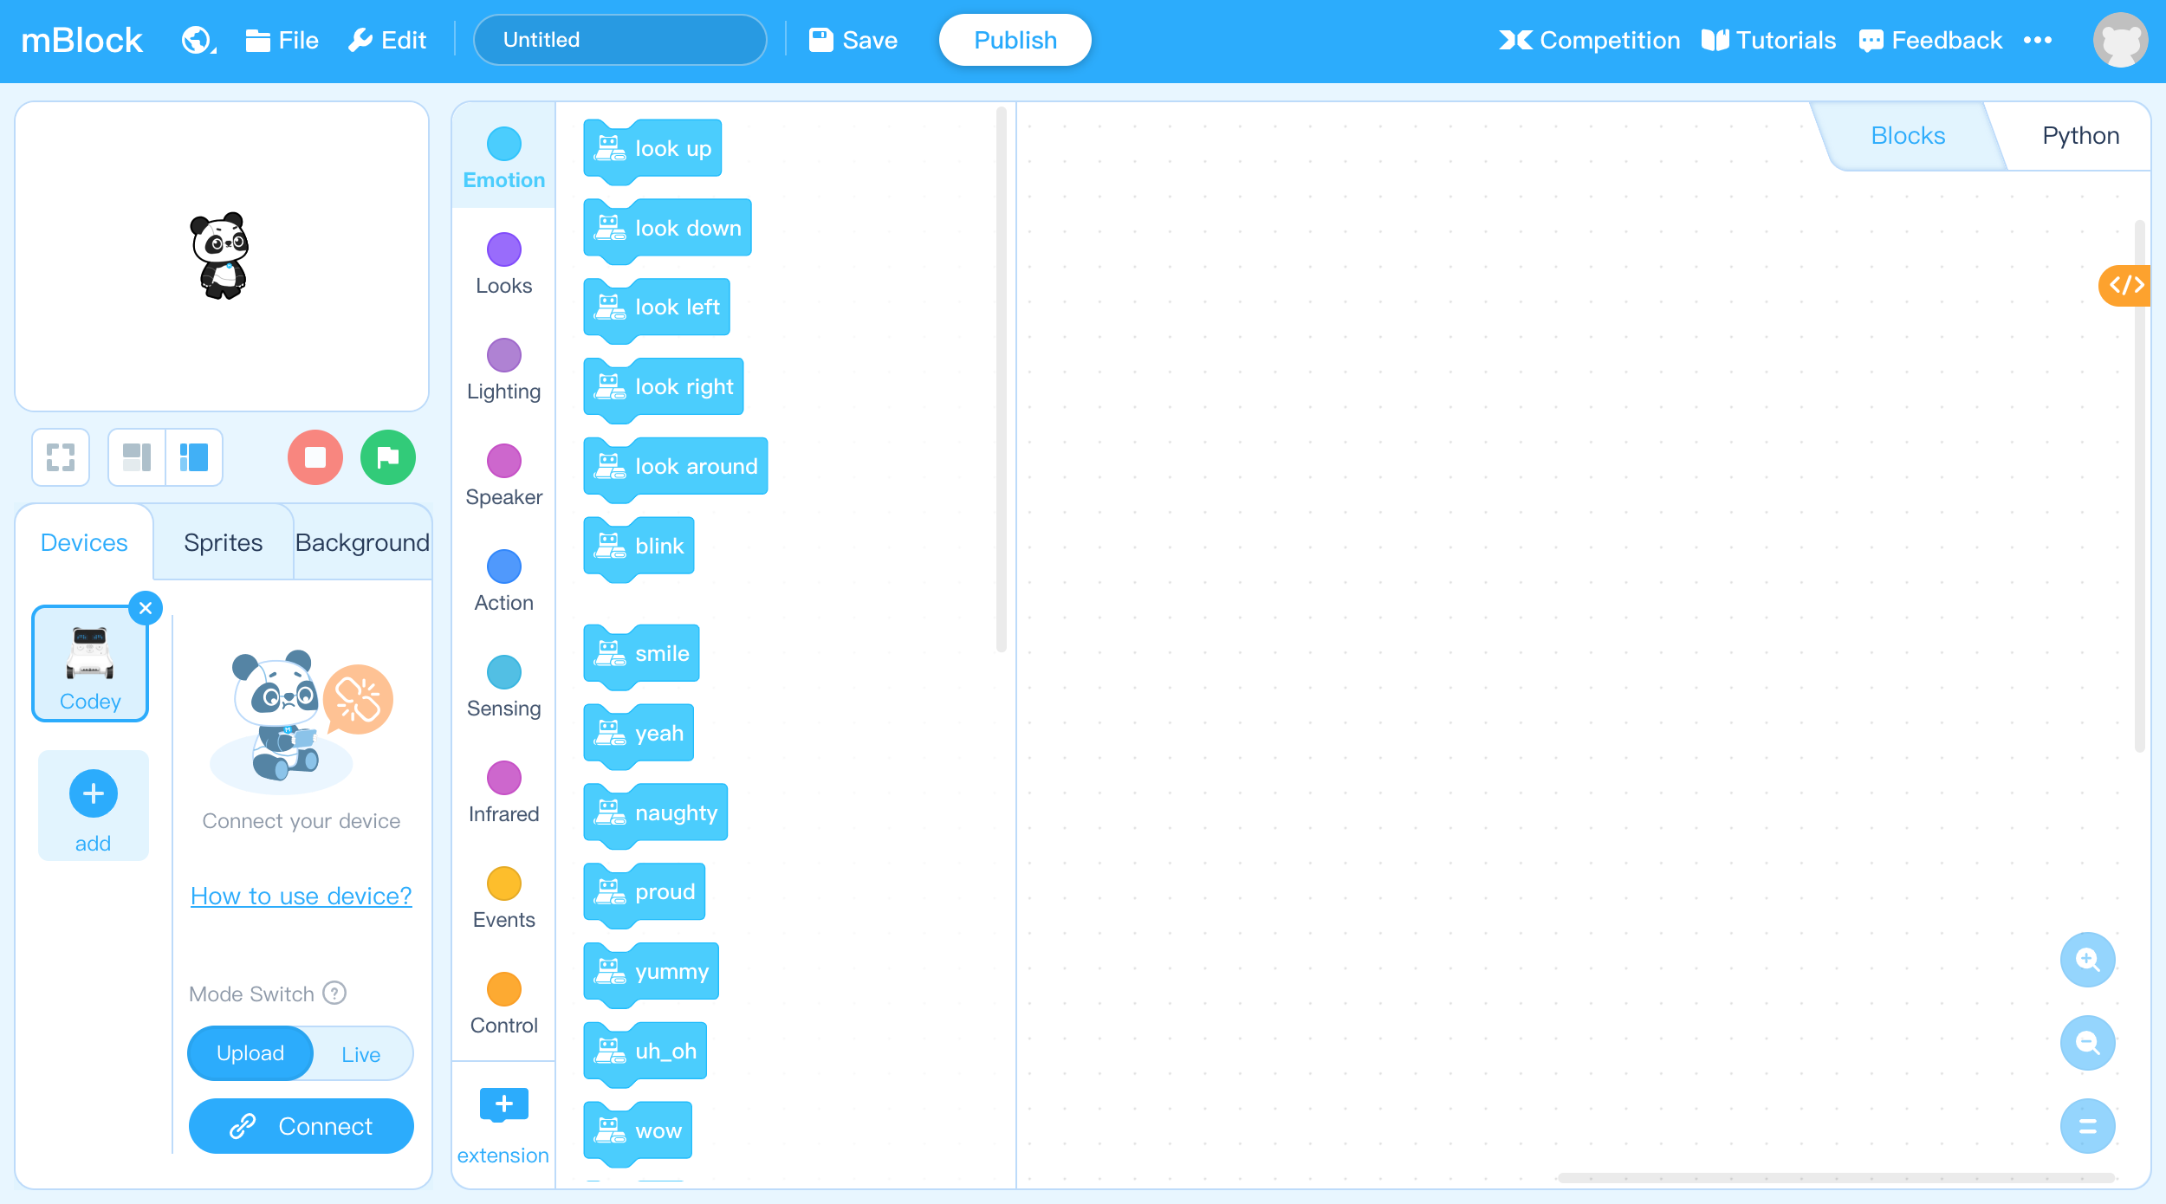
Programming Practice:
Moving Panda
,
Step 1: Find in the menu bar, select .

Slide 24
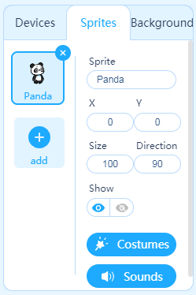
,
Step 2: Click the Sprites tab in the Stage Area to ensure that our program is added to the Panda sprite.

Slide 25

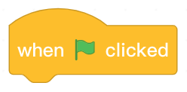
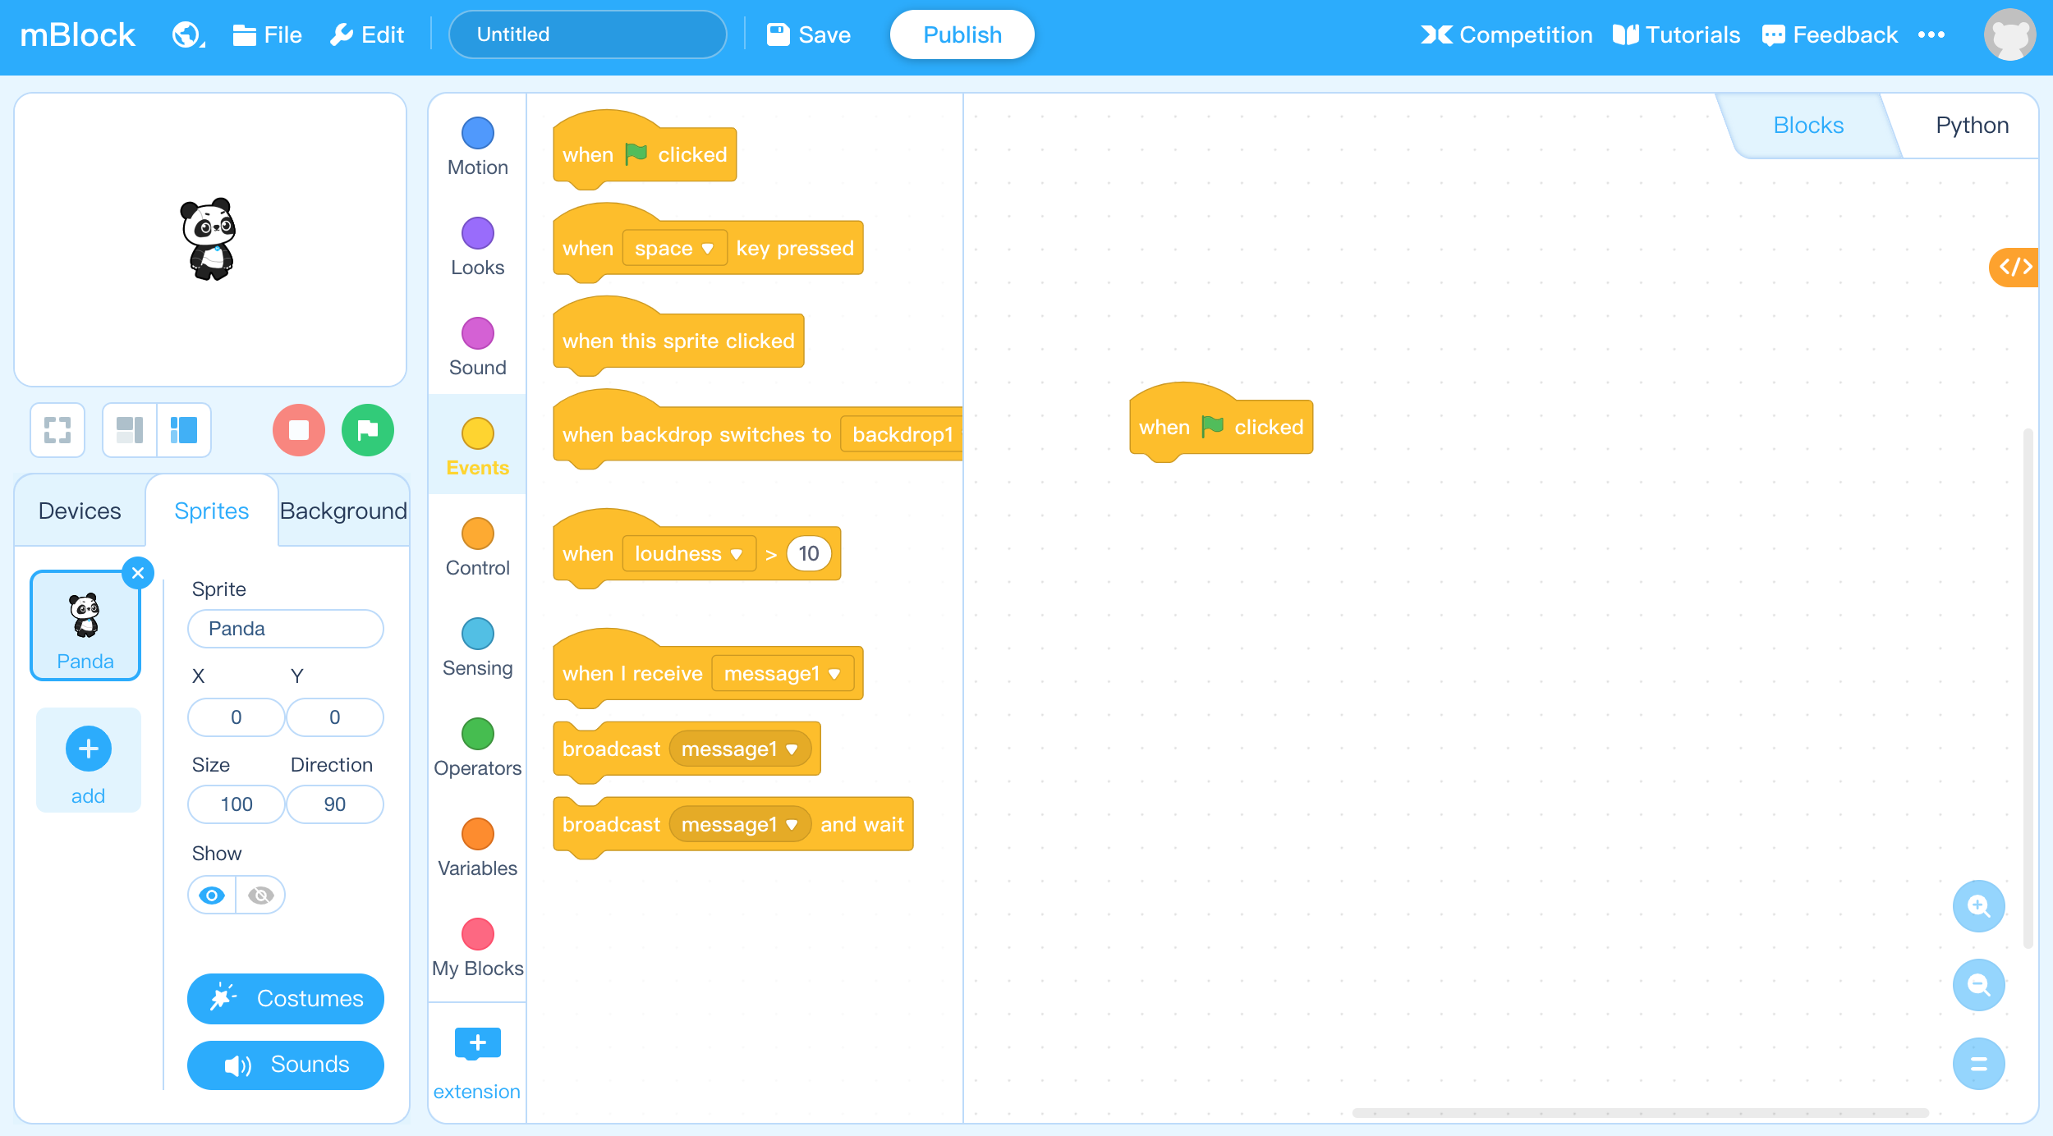
,
Step 3: Find and select from the Block Area.
Click the and drag it to the Script Area and the release it.

Slide 26

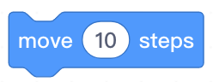
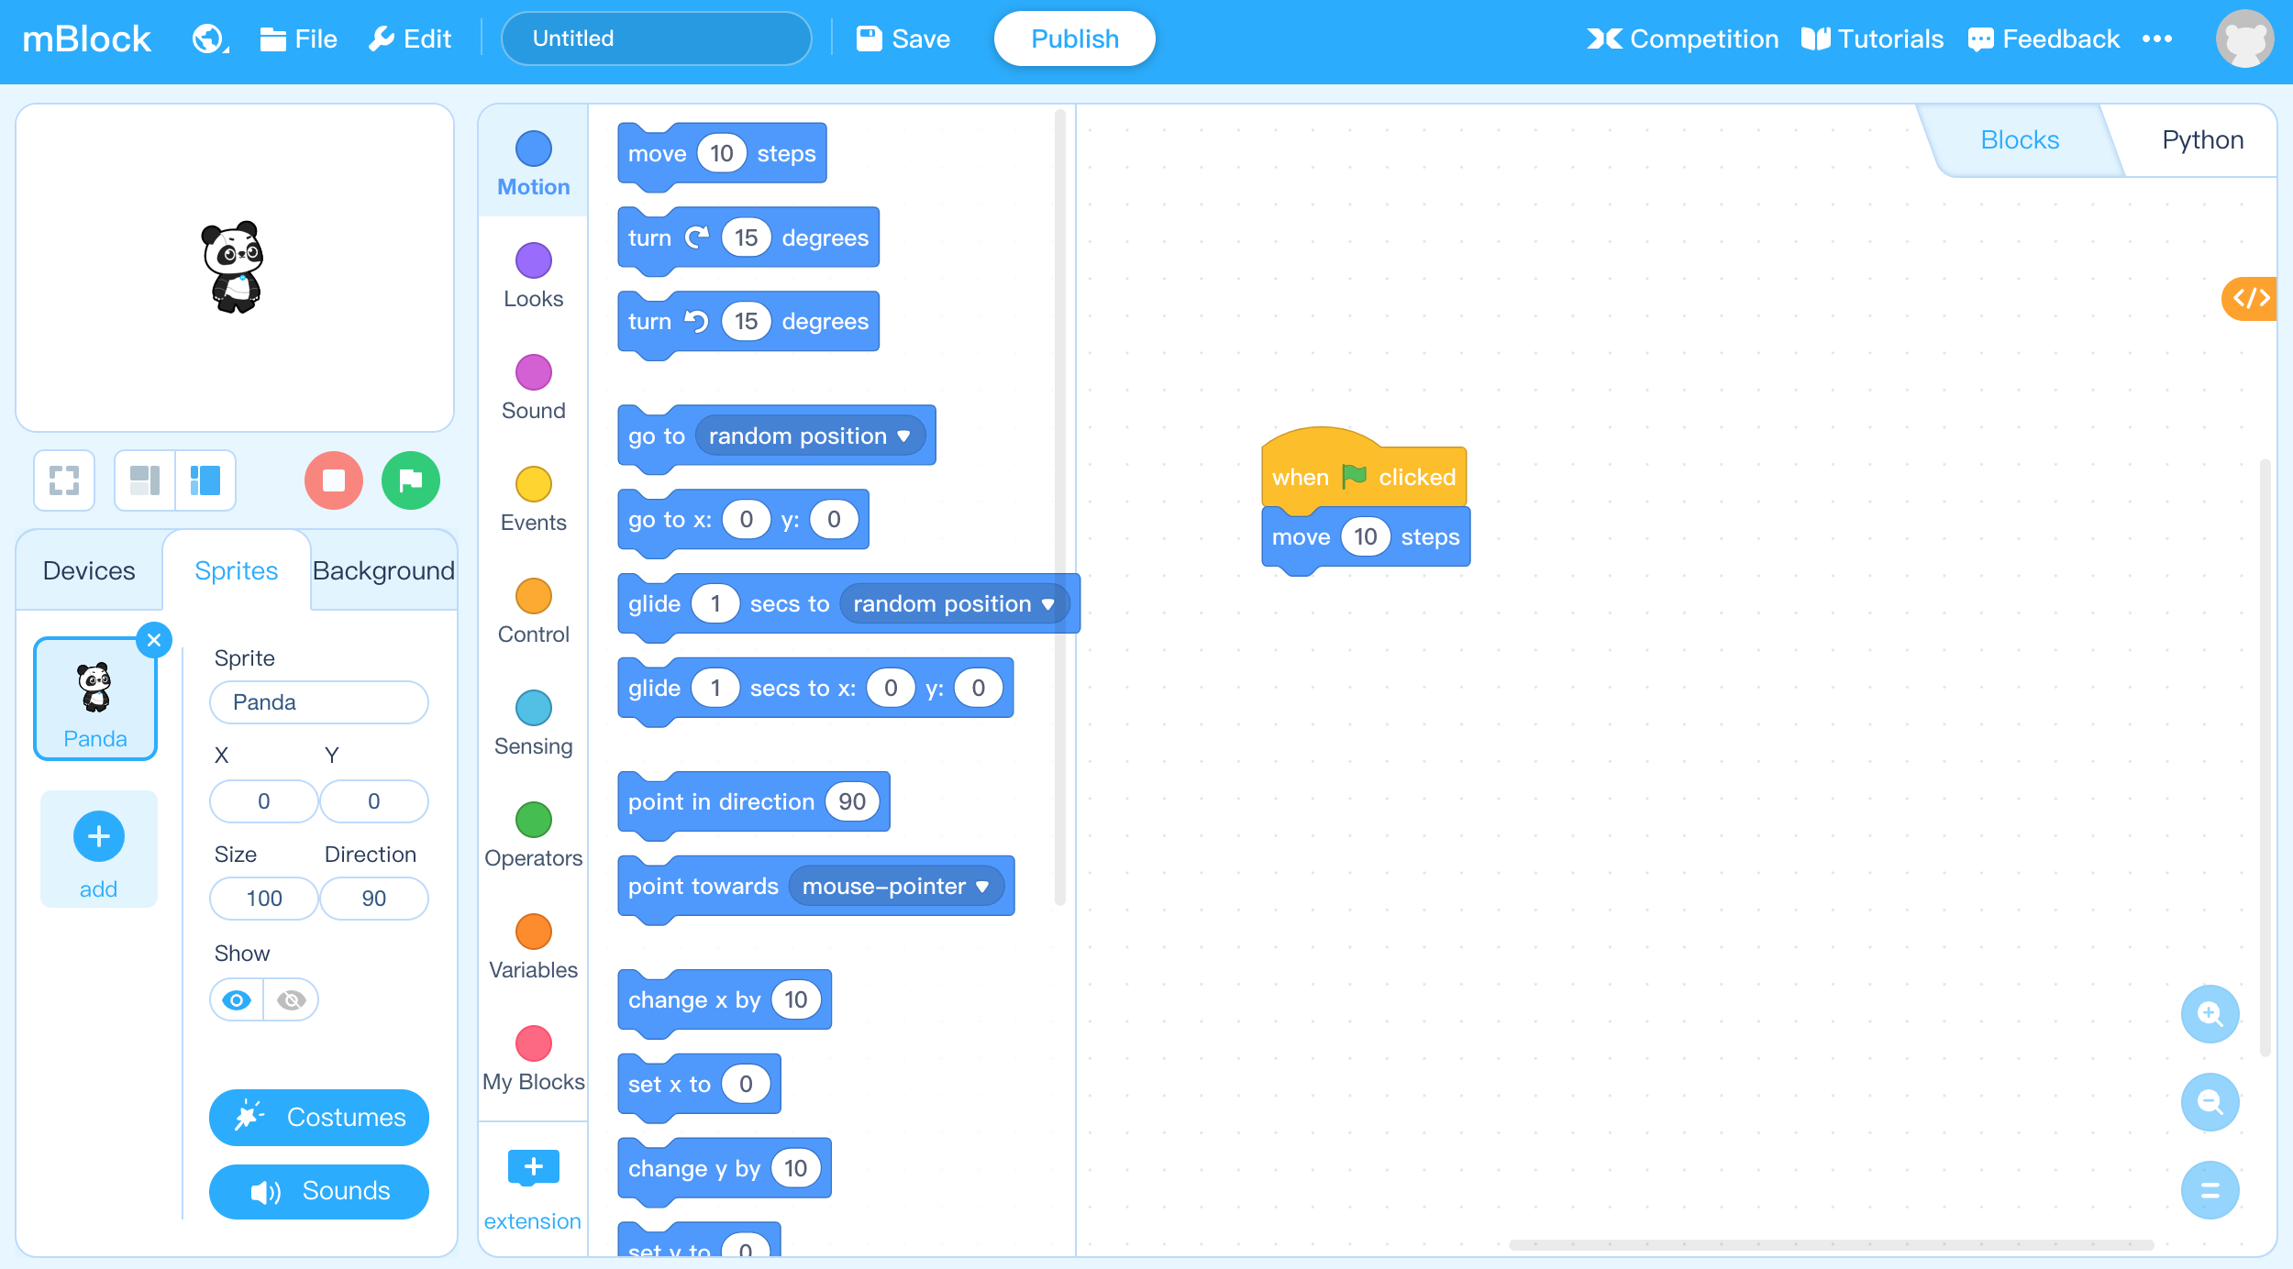
,
Step 4: Find and select from the Block Area.
Click the and drag it to the Script Area and attach it beneath the block.

Slide 27
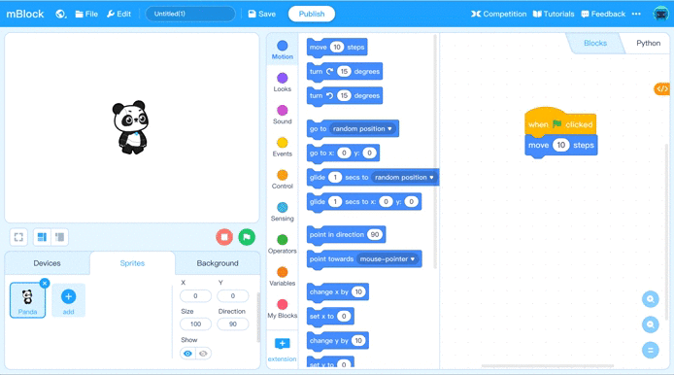
Step 5: Click the in the Stage Area to run the program and observe the animation in the stage.

Slide 28
Review

Slide 29
1. What’s the name of the area displaying the game interface when playing Space Adventures?
A. Block area
B. Script area
C. Menu Bar
D. Stage area
Notes:
Answer: D

Slide 30
2. What is the button to start the program in Space Adventures?
A.
B.
C.
D.
Notes:
Answer: B

Slide 31
2. Which of the following options is wrong about programming?
Programming is limited to building blocks.
Programming is the process of splicing the instructions that the computer can understand in a certain order.
Apps in mobile phones are developed by programming.
Various games can be developed by programming.
Notes:
Answer: A

Slide 32
Thank you!

